Slide 1
CDACL-002 - Customer Segmentation
Understanding Customer Behavior and Purchase Patterns
PRABU R
Datamites Internship
19-06-2026

Slide 2
Project Overview
Objective
The objective of this project is to analyze customer shopping behavior and identify valuable customer segments using purchase data.
Business Goals
Identify discount opportunities.
Analyze spending patterns.
Segment customers.
Improve customer retention.
Support business decision-making

Slide 3
Business Problem Statement
Businesses need to understand:
Which product categories require discounts.
How spending varies across age groups.
The impact of seasons and locations.
How customers can be segmented for targeted marketing.
This project helps businesses make data-driven marketing decisions using customer segmentation.

Slide 4
Dataset Understanding
Dataset Information
Total Customers: 3900
Attributes Used
Customer_ID
Age
Gender
Category
Purchase Amount
Location
Season
Payment Method
Subscription Status
Review Rating
Frequency of Purchases

Slide 5
Data preprocessing
Excel Transformations
Customer Segment Creation
Using IF Function:
High Value
Medium Value
Low Value
Review Category Creation
Created based on review ratings.
Subscription Status Conversion
Yes = 1
No = 0
Age Group Creation
18–25
26–35
36–45
46–55
56+

Slide 6
Customer segmentation
Clusters Created
High Value Customers
High purchase amount
Frequent purchases
High revenue contribution
Medium Value Customers
Regular customers
Moderate spending
Low Value Customers
Less spending
Need promotional engagement

Slide 7
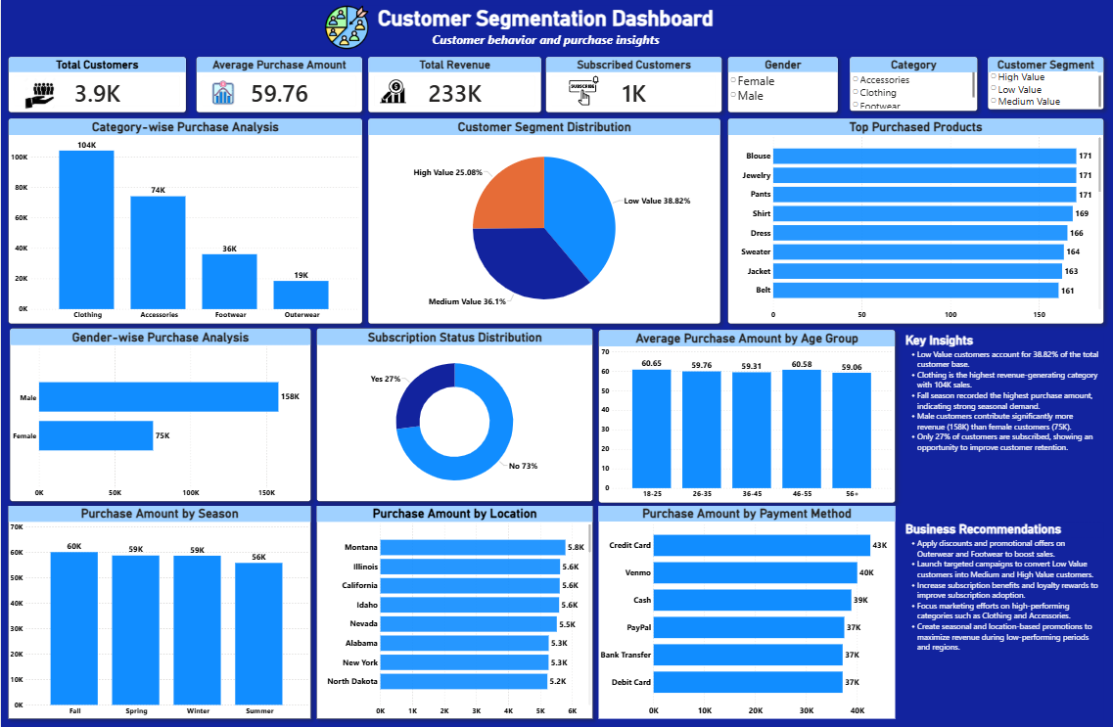
Dashboard Overview

Slide 8
Customer Segment Analysis
Customer Segment Distribution
Results
Segment | Percentage
Low Value | 38.82%
Medium Value | 36.10%
High Value | 25.08%
Analysis
Low Value customers form the largest segment.
High Value customers contribute significant business value.
Medium Value customers provide opportunities for growth.
Business Impact
Businesses should focus on converting Low Value customers into Medium or High Value customers.

Slide 9
Revenue Analysis
Category-wise Purchase Analysis
Revenue Contribution
Category | Revenue
Clothing | 104K
Accessories | 74K
Footwear | 36K
Outerwear | 19K
Key Findings
Clothing generates the highest revenue.
Accessories are the second highest contributor.
Outerwear contributes the least revenue.
Business Impact
Marketing campaigns should prioritize Clothing and Accessories categories.

Slide 10
Customer Behaviour Analysis
1.Gender-wise Purchase Analysis
Male Customers Revenue = 158K
Female Customers Revenue = 75K
Insight
Male customers contribute significantly more revenue.
2.Subscription Analysis
Active Subscribers = 27%
Non-Subscribers = 73%
Insight
Subscription adoption is low and requires improvement.

Slide 11
3.Age Group Analysis
Average Purchase Amount by Age Group
Age Group | Average Purchase
18–25 | 60.65
26–35 | 59.76
36–45 | 59.31
46–55 | 60.58
56+ | 59.06
Insight
Purchasing behavior remains relatively consistent across age groups.
Customers aged 18–25 and 46–55 show slightly higher average purchase values.
Spending patterns remain relatively stable across all age groups

Slide 12
Top Purchased Products Analysis
Most Purchased Products
Top purchased items include:
Blouse
Jewelry
Pants
Shirt
Dress
Sweater
Analysis
These products show high customer demand.
Business Impact
Fashion products contribute significantly to customer purchases.
Inventory planning should focus on high-demand products.
Promotional campaigns can target top-selling products to increase revenue.

Slide 13
Season & location analysis
Season Analysis
Fall → Highest Revenue
Spring → Strong Performance
Winter → Moderate
Summer → Lowest Revenue
Location Analysis
Top Revenue States:
Montana
Illinois
California
Idaho
Nevada
Conclusion Season and location influence purchasing trends.

Slide 14
Payment method analysis
Top Payment Methods:
Credit Card
Venmo
Cash
PayPal
Bank Transfer
Observation Digital payments dominate customer transactions

Slide 15
Key Business Insights
Total Customers = 3900
Total Revenue = 233K
Average Purchase = $59.76
Clothing generates highest revenue
Outerwear generates lowest revenue
Fall season performs best
Male customers contribute more revenue
Only 27% customers are subscribed
Low Value customers form largest segment

Slide 16
Business Recommendations
Offer discounts on Outerwear and Footwear.
Improve subscription benefits.
Create loyalty programs for High Value customers.
Run promotional campaigns for Low Value customers.
Focus marketing during Fall season.
Target top-performing locations with premium campaigns.
Promote digital payment offers.
Use customer segmentation for personalized marketing

Slide 17
Conclusion
The project successfully analyzed customer purchase behavior and segmented customers into High, Medium and Low Value groups.
The analysis identified:
Best performing categories
Discount opportunities
Seasonal trends
Location-based trends
Customer spending behavior
These insights help businesses improve revenue, retention and customer satisfaction.

Slide 18
Thank You

